Slide 1
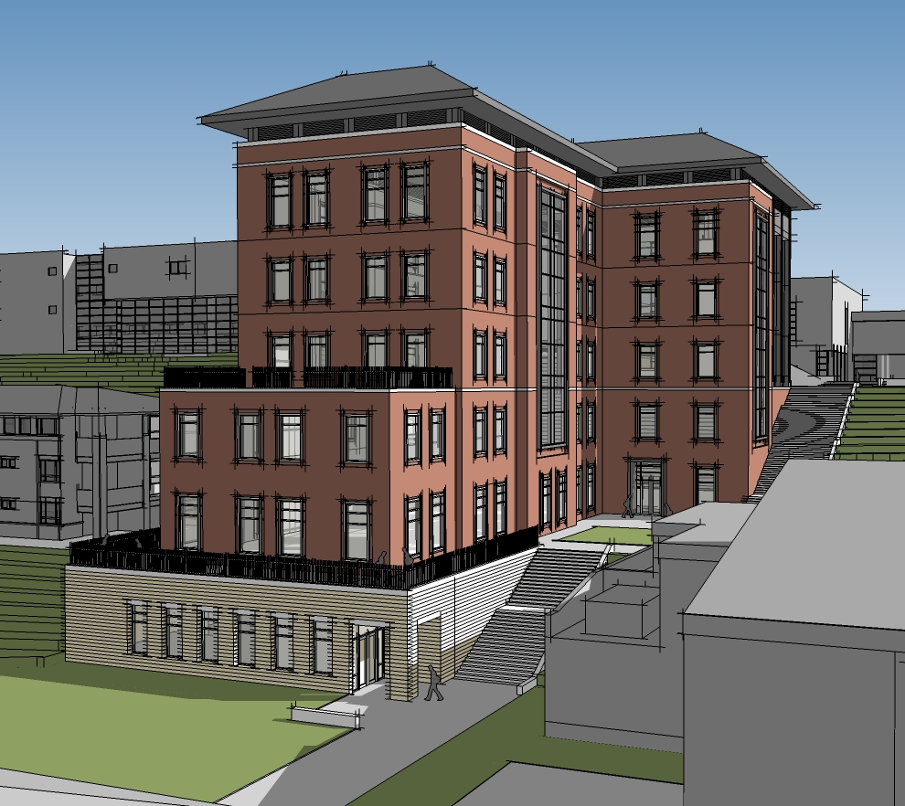
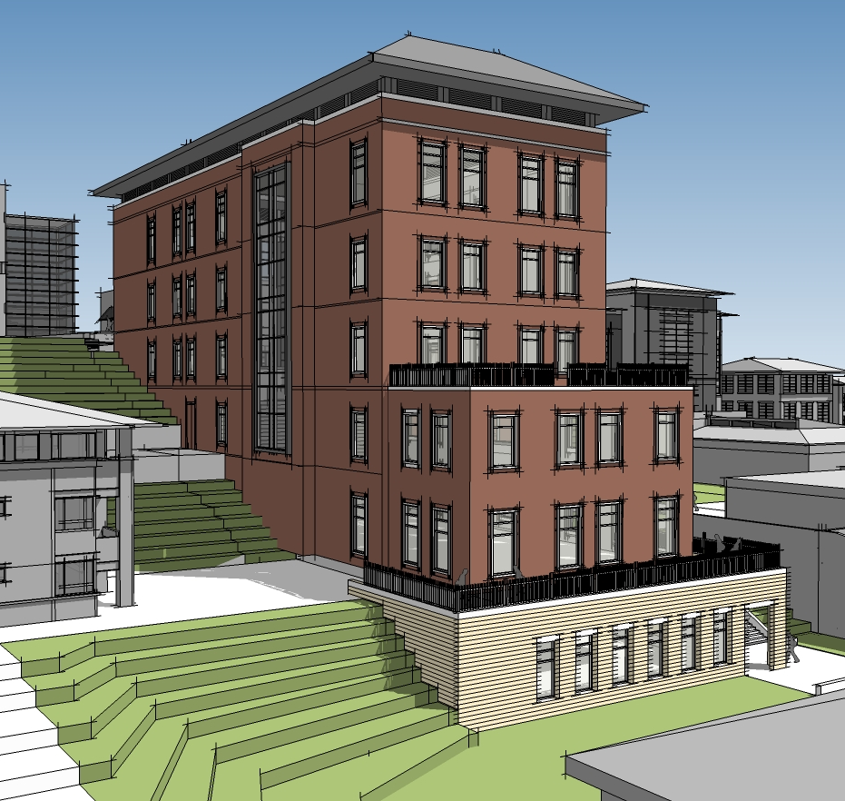
The New Library at the
University of Virginia’s College at Wise
Macenzie Ceglar | Structural Option
Advisor : Heather Sustersic
May 2, 2014
Image Courtesy of Cannon Design
Image Courtesy of Cannon Design

Slide 2
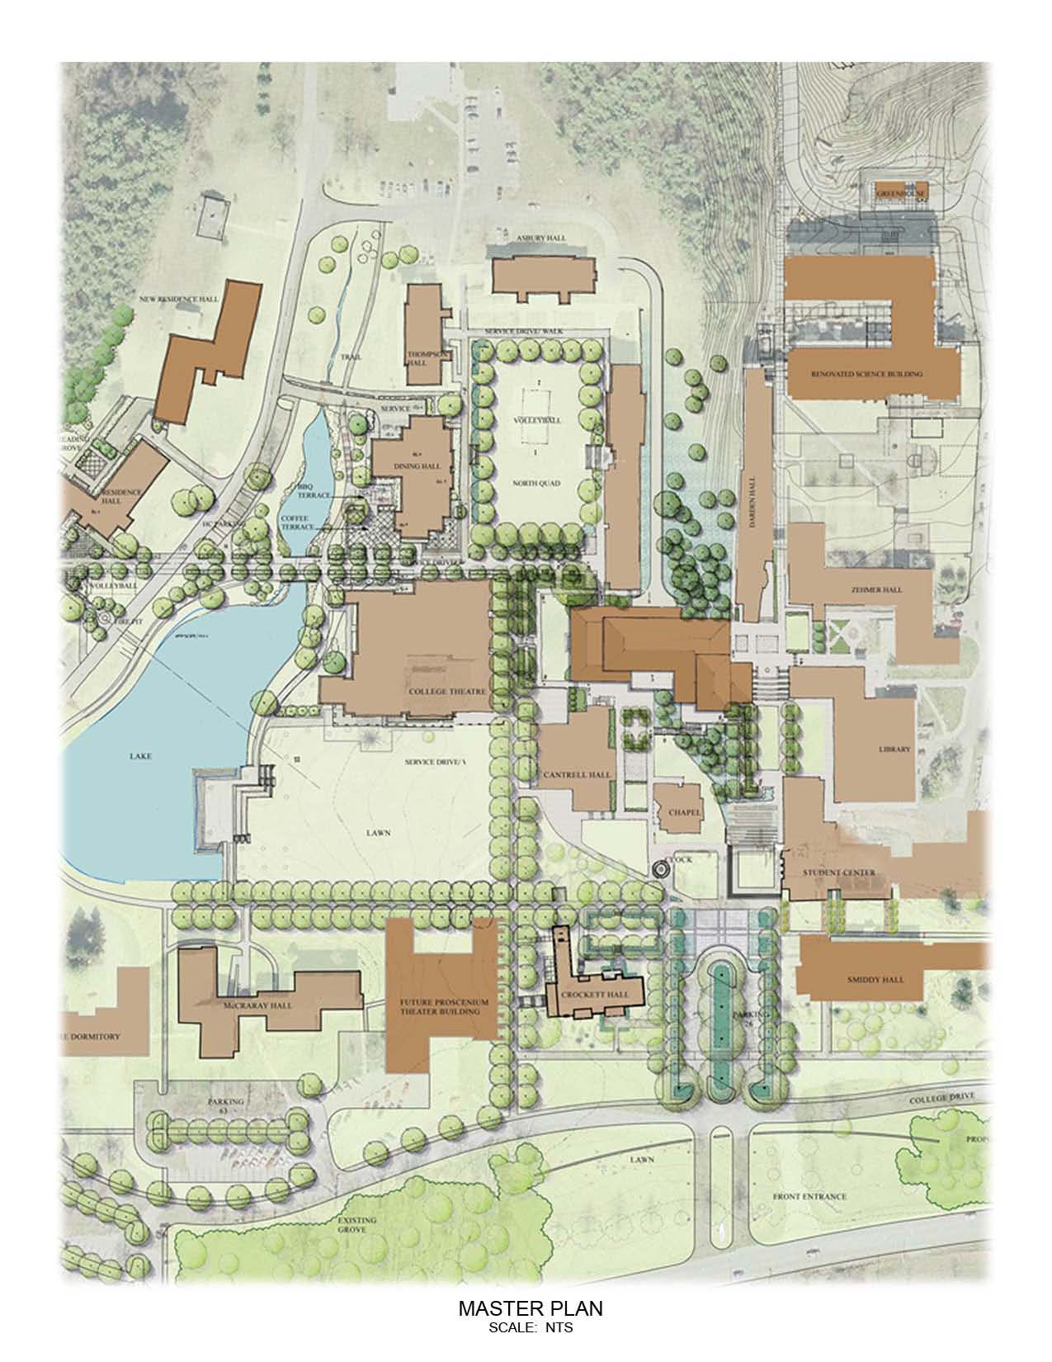
UVA’s New Library
Building Introduction
N
Building Introduction
  Statistics
  Gravity System
  Lateral System
Problem Statement & Solution
Two-way System
PT System
Lateral System
Cost and Schedule Analysis
System Comparison
Conclusion
Owner: University of Virginia
Architecture & Engineering: Cannon Design
Size: 68,000 GSF
Stories Above Grade: 6
Height: 102 FT
Cost: $43 Million
August 2012 – August 2015
Image Courtesy of Cannon Design

Slide 3
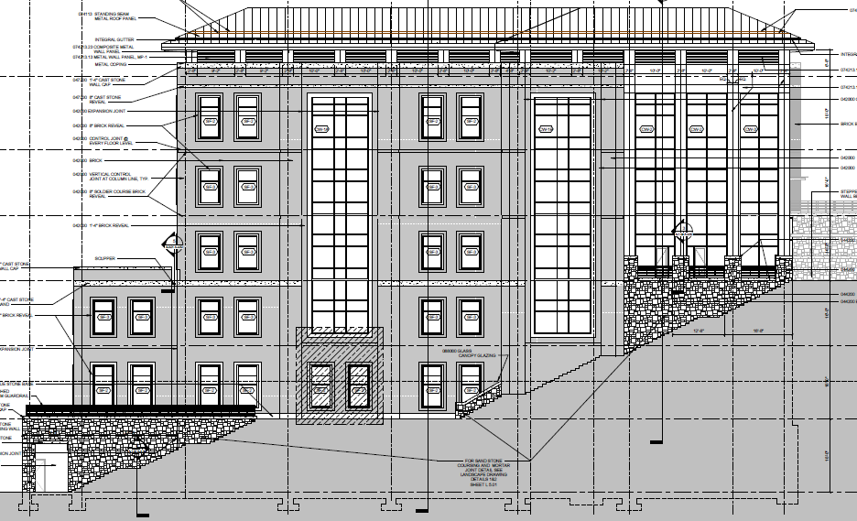
UVA’s New Library
Building Introduction
Building Introduction
  Statistics
  Gravity System
  Lateral System
Problem Statement & Solution
Two-way System
PT System
Lateral System
Cost and Schedule Analysis
System Comparison
Conclusion
Unique Feature: Integration into 60 Hill Side
N
Image Courtesy of Cannon Design
Image from Construction Documents

Slide 4
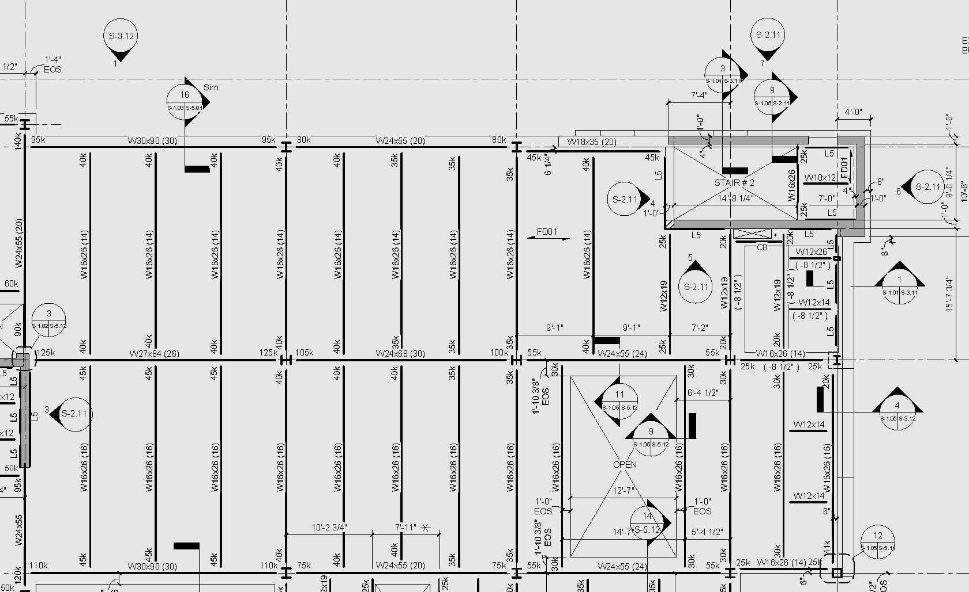
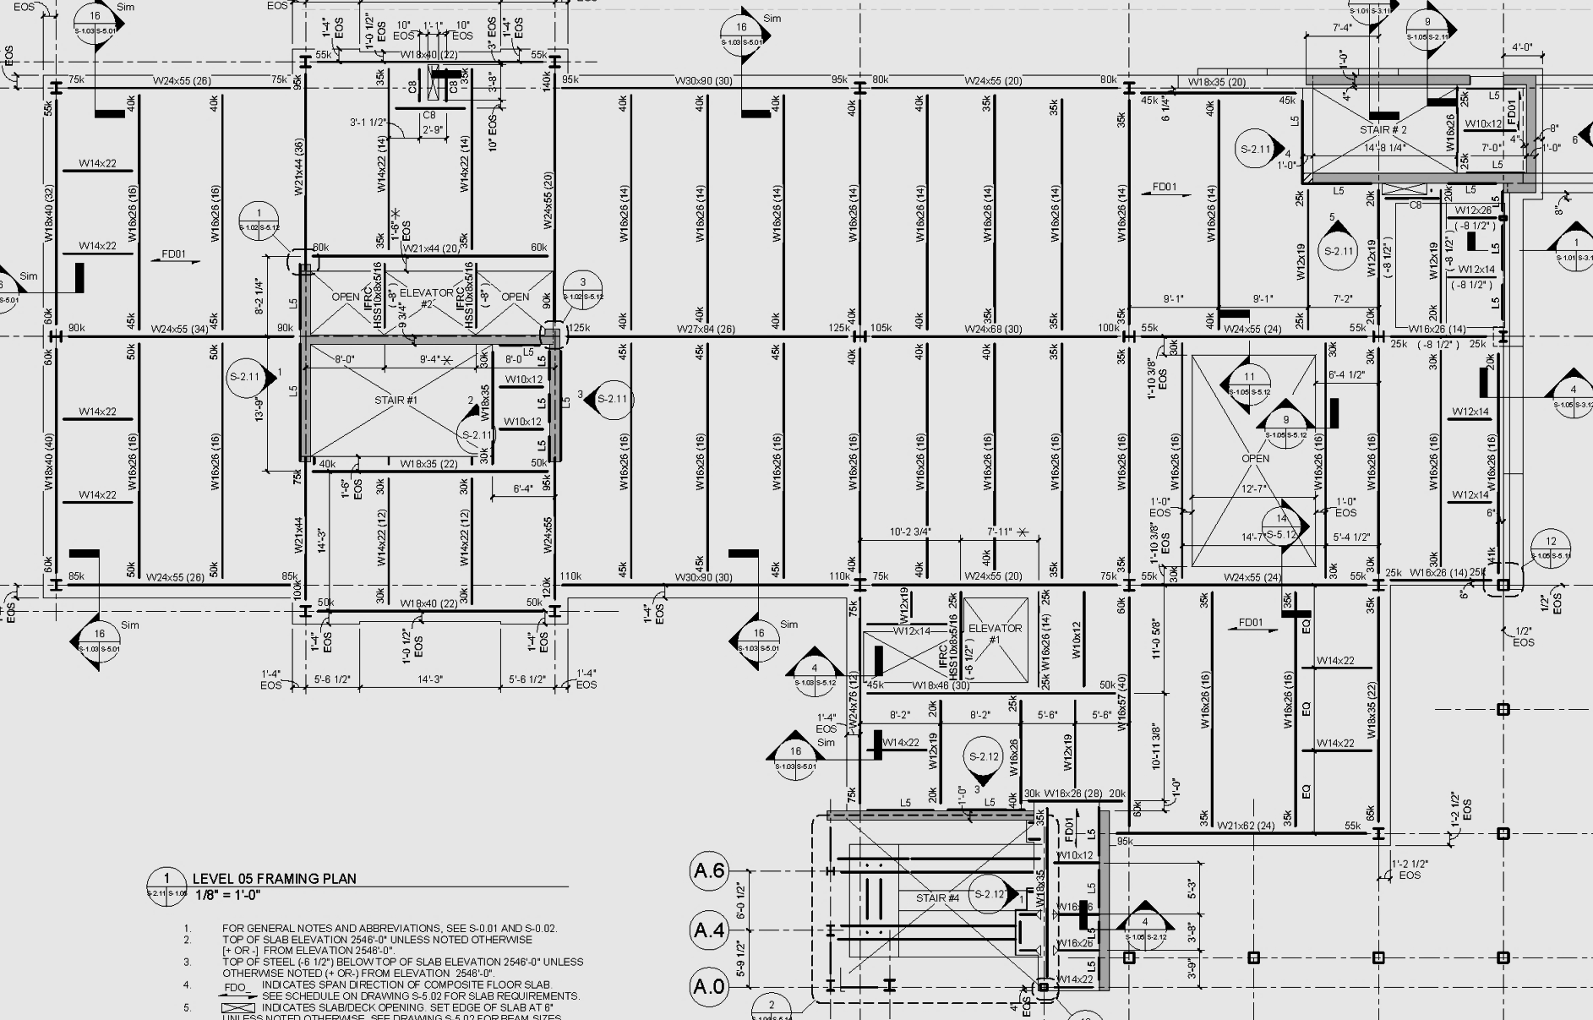
UVA’s New Library
Existing Gravity System
31’-0”
27’-4”
25’-4”
Building Introduction
  Statistics
  Gravity System
  Lateral System
Problem Statement & Solution
Two-way System
PT System
Lateral System
Cost and Schedule Analysis
System Comparison
Conclusion
Spread/Strip Footings
Temporary-Leave-In-Place Retaining Wall System
Composite Steel Floor Framing
  2” 18 ga. Metal Decking
  4 ½” NWC Topping
  3 ½” x ¾” Studs
Wide Flange Members
Typical Bay Size: 25’-4” x 25’-4”
25’-4”
25’-4”
Images from Construction Documents

Slide 5
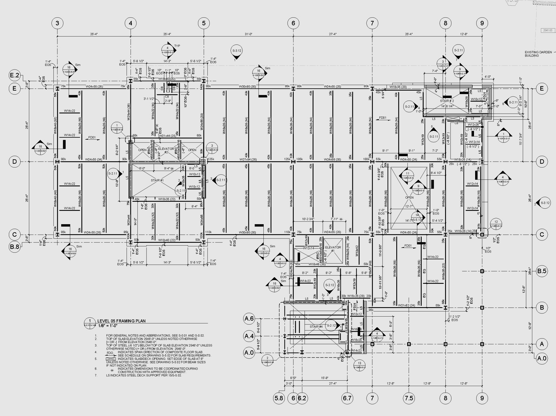
UVA’s New Library
Existing Lateral System
N
Building Introduction
  Statistics
  Gravity System
  Lateral System
Problem Statement & Solution
Two-way System
PT System
Lateral System
Cost and Schedule Analysis
System Comparison
Conclusion
Ordinary reinforced concrete shear walls
  12” thick
  #5 rebar @ 18” EW EF
Located near stairs and elevator shafts
Image from Construction Documents

Slide 6
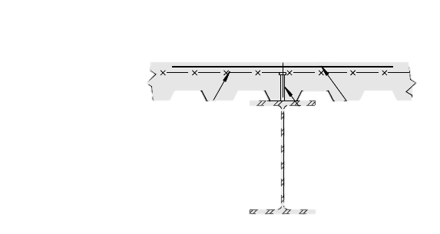
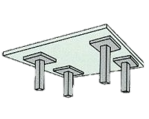
UVA’s New Library
Problem Statement
Proposed Solution
Building Introduction
Problem Statement & Solution
Two-way System
PT System
Lateral System
Cost and Schedule Analysis
System Comparison
Conclusion
Exiting structure well designed
Problem Scenario
  Redesign the structure in concrete
  Redesign structural systems as a two-way concrete slab system
  Address deflections in longer span bays
  Investigate the possibility of a post-tensioned system
  Determine feasibility of a concrete system
    Consider cost and schedule impact

Slide 7
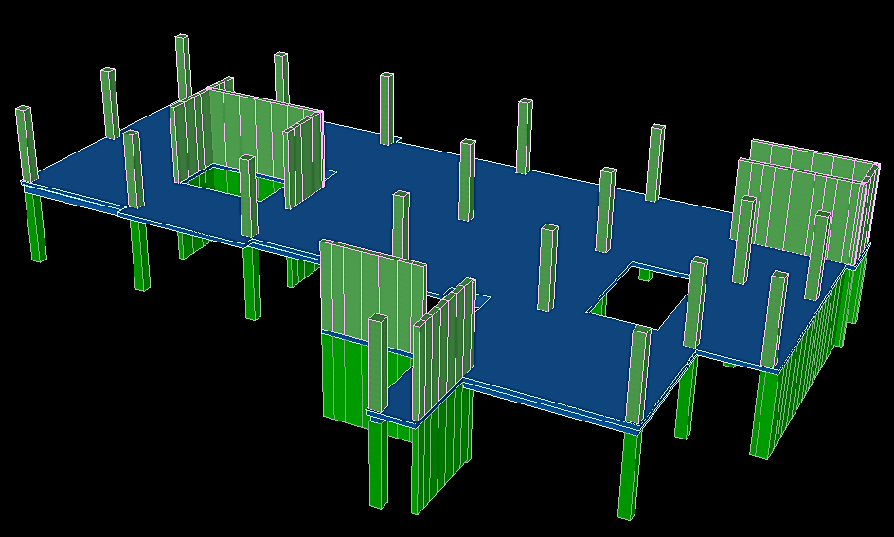
UVA’s New Library
Building Introduction
Problem Statement & Solution
Two-way System
PT System
Lateral System
Cost and Schedule Analysis
System Comparison
Conclusion
Two-Way Concrete System

Slide 8
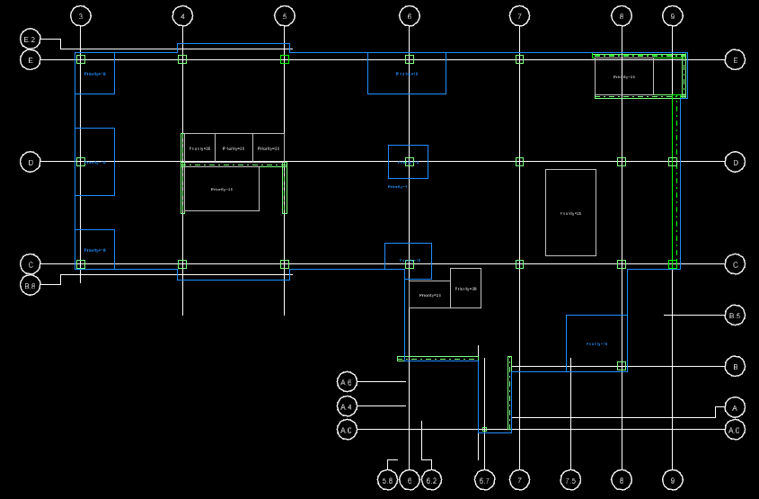
UVA’s New Library
Floor Slab Design
Building Introduction
Problem Statement & Solution
Two-way System
  Floor Slab Design
  Deflection Checks
  Final Slab Design
  Column Design
PT System
Lateral System
Cost and Schedule Analysis
System Comparison
Conclusion
Trial slab thickness: 10”
Drop Panel Sizes:
  L/6 in each direction
  Thickness: 1.25h =12.5”
Punching shear controlled design
N
Column | -X (FT) | +X (FT) | -Y (FT) | +Y (FT) | Thickness (IN) | Required an Increase in Size
3E | 1.33 | 8.44 | 8.44 | 1.33 | 6 | Yes
3D | 1.33 | 8.44 | 8.44 | 8.44 | 9 | Yes
3C | 1.33 | 8.44 | 1.33 | 8.44 | 9 | Yes
6E | 10.33 | 9.11 | 8.44 | 1.33 | 4 | Yes
6D | 5.17 | 4.56 | 4.22 | 4.22 | 6 | No
6C | 6.20 | 5.47 | 3.83 | 5.07 | 2.5 | Yes
8B | 13.67 | 1.33 | 1.33 | 12.67 | 13 | Yes

Slide 9
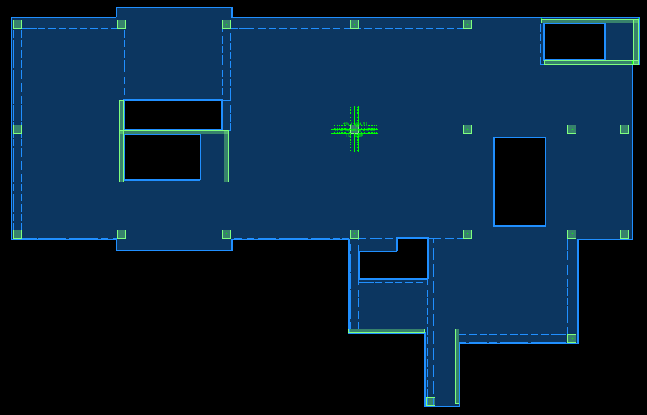
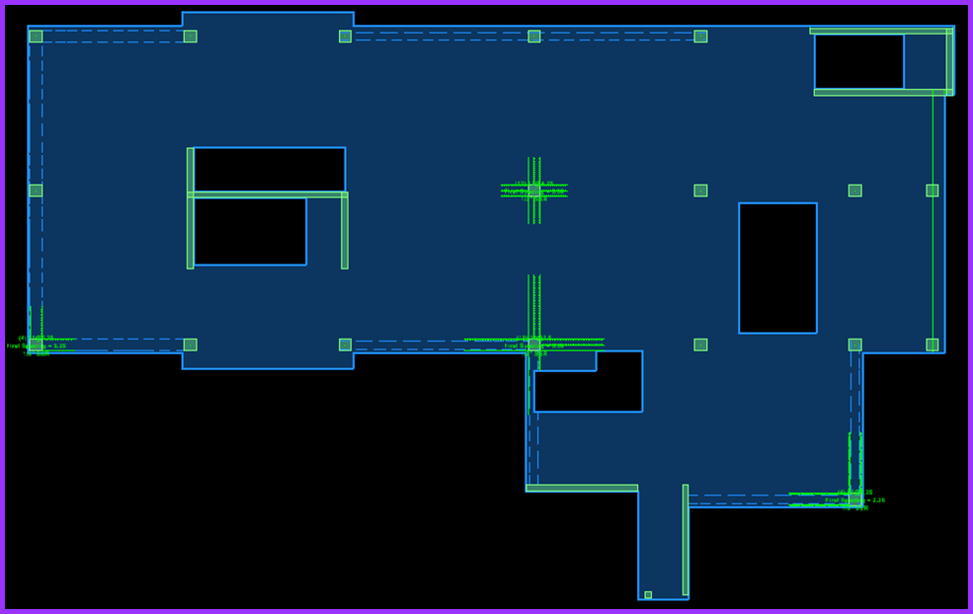
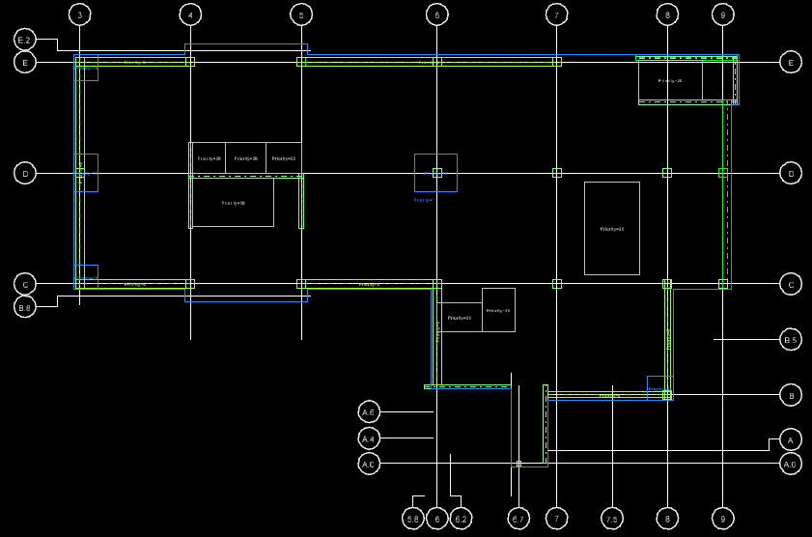
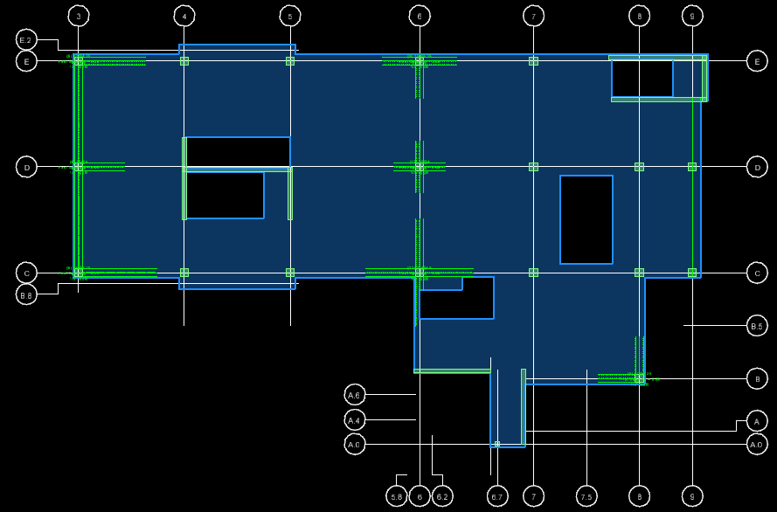
UVA’s New Library
Trial Floor Slab Designs
Building Introduction
Problem Statement & Solution
Two-way System
  Floor Slab Design
  Deflection Checks
  Final Slab Design
  Column Design
PT System
Lateral System
Cost and Schedule Analysis
System Comparison
Conclusion
Drop Panels Only
Shear Studrails
Drop Panels & Edge Beams
Shear Studrails & Edge Beams

Slide 10
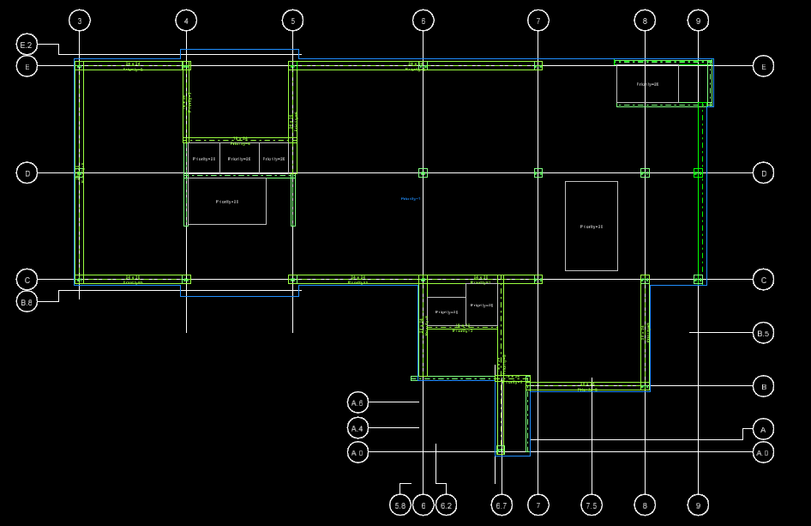
UVA’s New Library
Deflections
Building Introduction
Problem Statement & Solution
Two-way System
  Floor Slab Design
  Deflection Checks
  Final Slab Design
  Column Design
PT System
Lateral System
Cost and Schedule Analysis
System Comparison
Conclusion
Maximum Allowable Deflection: L/480
Initial Deflections:
Span | Length (FT) | Deflection | L/480 | Pass/Fail
5D - 6D | 31 | 1.33 | 0.775 | Fail
6D - 7D | 27.33 | 1.02 | 0.683 | Fail
5E - 6D | 40 | 1.43 | 1.0 | Fail
6E - 7D | 37.33 | 1.24 | 0.933 | Fail
5C- 6D | 40 | 1.33 | 1.0 | Fail

Slide 11
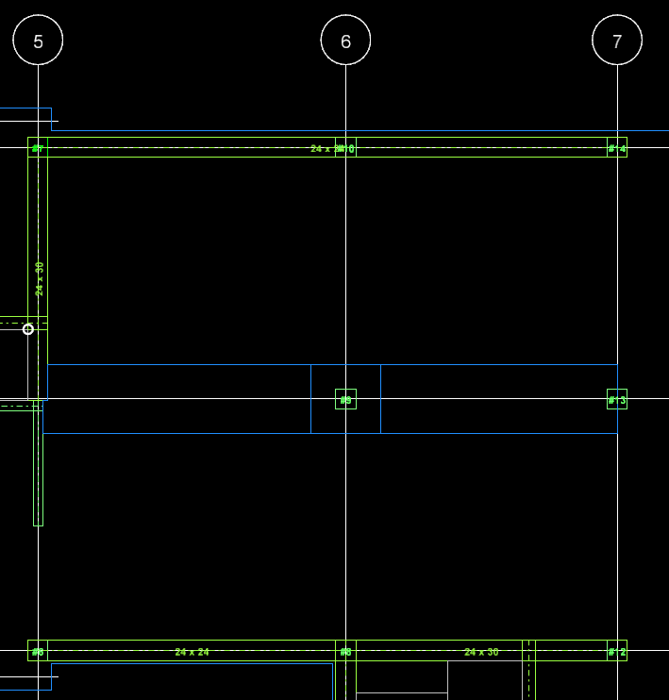
UVA’s New Library
Deflections
Building Introduction
Problem Statement & Solution
Two-way System
  Floor Slab Design
  Deflection Checks
  Final Slab Design
  Column Design
PT System
Lateral System
Cost and Schedule Analysis
System Comparison
Conclusion
Trial Design Solutions:
  Weighted Average
  Compression Reinforcement
  Drop Panels
  Shallow Beams
Span | Length (FT) | Deflection | L/480 | Pass/Fail
5D - 6D | 31 | 0.709 | 0.775 | Pass
6D - 7D | 27.33 | 0.511 | 0.683 | Pass
5E - 6D | 40 | 0.875 | 1.0 | Pass
6E - 7D | 37.33 | 0.817 | 0.933 | Pass
5C- 6D | 40 | 0.827 | 1.0 | Pass

Slide 12
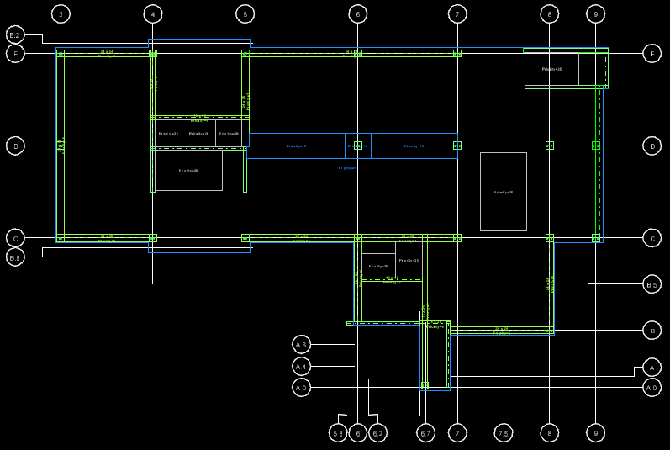
UVA’s New Library
Final Floor Slab Design
Building Introduction
Problem Statement & Solution
Two-way System
  Floor Slab Design
  Deflection Checks
  Final Slab Design
  Column Design
PT System
Lateral System
Cost and Schedule Analysis
System Comparison
Conclusion
Slab thickness: 10”
Drop Panel: 7’ x 7’ x 6”
Shallow Beam: 7’ x 14”
Additional edge beams and interior beams
Program output verified by hand

Slide 13
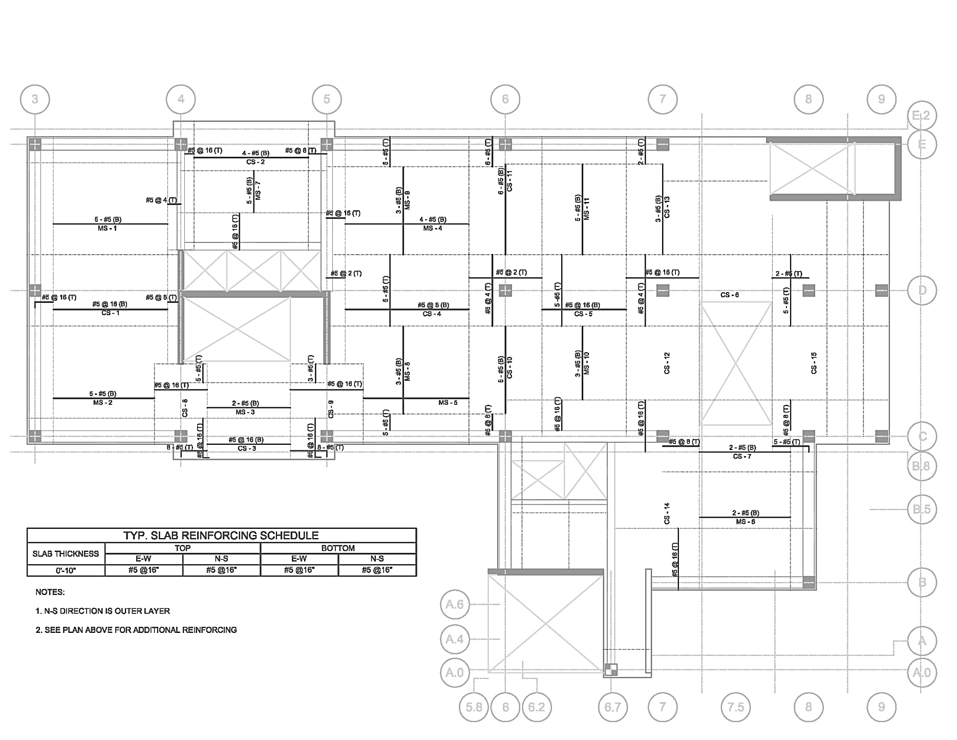
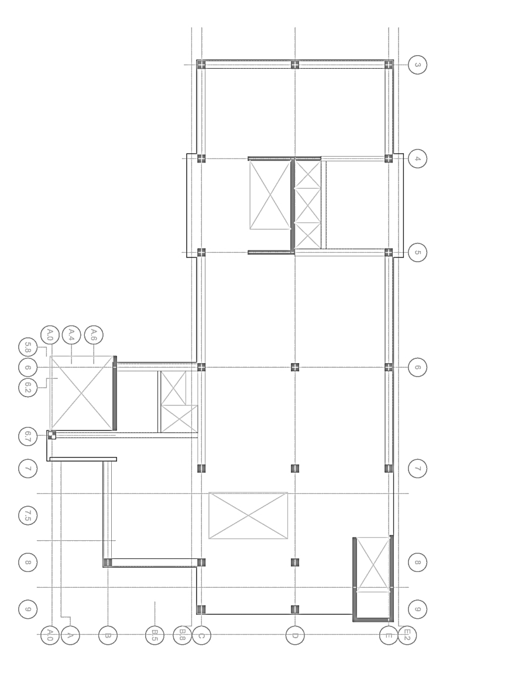
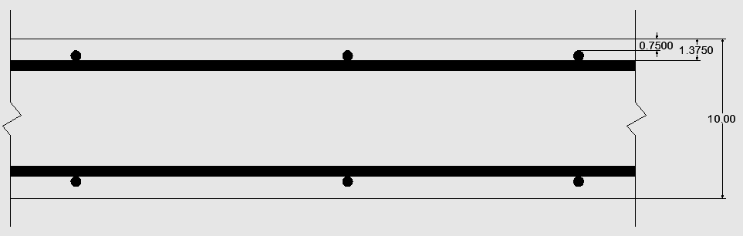
UVA’s New Library
Slab Reinforcement
Building Introduction
Problem Statement & Solution
Two-way System
  Floor Slab Design
  Deflection Checks
  Final Slab Design
  Column Design
PT System
Lateral System
Cost and Schedule Analysis
System Comparison
Conclusion
Typical Slab Reinforcing Schedule
Slab Thickness | Top Mat |  | Bottom Mat
 | E-W | N-S | E-W | N-S
0’-10” | #5 @ 16” | #5 @ 16” | #5 @ 16” | #5 @ 16”

Slide 14
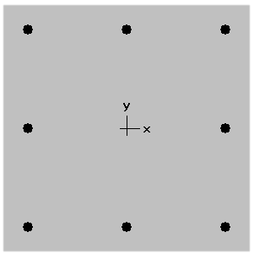
UVA’s New Library
Column Redesign
Building Introduction
Problem Statement & Solution
Two-way System
  Floor Slab Design
  Deflection Checks
  Final Slab Design
  Column Design
PT System
Lateral System
Cost and Schedule Analysis
System Comparison
Conclusion
Typical:
Non-Typical Columns:
  6D
  6C
  7C
24” X 24”
(8) # 8 Long. Bars
#3 Ties
Image from Construction Documents

Slide 15
UVA’s New Library
Column Redesign
Building Introduction
Problem Statement & Solution
Two-way System
  Floor Slab Design
  Deflection Checks
  Final Slab Design
  Column Design
PT System
Lateral System
Cost and Schedule Analysis
System Comparison
Conclusion
Level | P_{u} (k) | øPn/Pu
6 | 185 | 6.5
5 | 495 | 2.4
4 | 803 | 1.5
3 | 1112 | 1.08
2 | 1420 | 1.24
1 | 1730 | 1.02
24” x 24”
(8) #8 Bars
28” x 28”
(16) #8 Bars
Image from Construction Documents

Slide 16
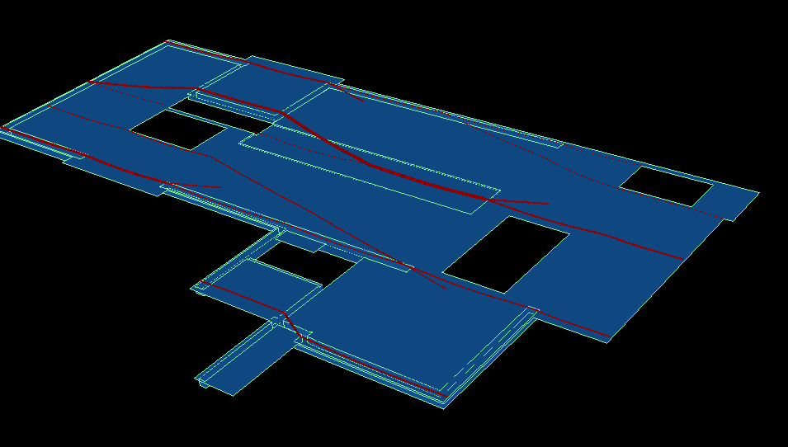
UVA’s New Library
Building Introduction
Problem Statement & Solution
Two-way System
PT System
Lateral System
Cost and Schedule Analysis
System Comparison
Conclusion
Post-Tensioned Concrete System

Slide 17
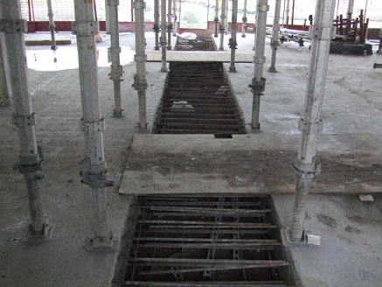
UVA’s New Library
Unfavorable Factors
Solution: Pour Strips and Slip Joints
Building Introduction
Problem Statement & Solution
Two-way System
PT System
  Tendon Layout
  Number of Tendons
  Deflections
  Final Layout
Lateral System
Cost and Schedule Analysis
System Comparison
Conclusion
Unfavorable Arrangement of Shear Walls and Location of Foundation Walls

Slide 18
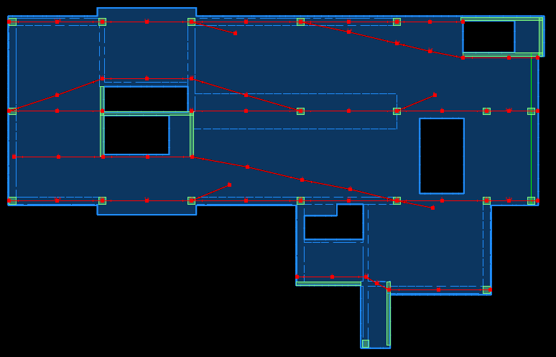
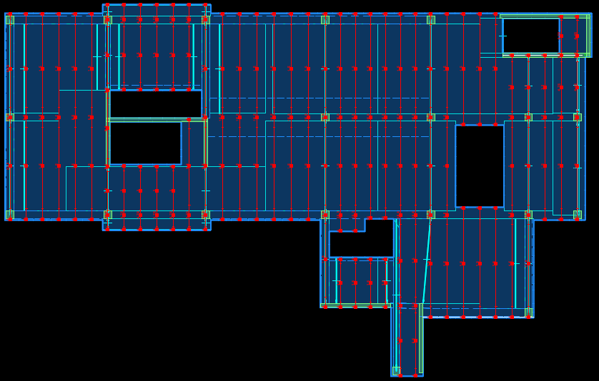
UVA’s New Library
Tendon Layout
Building Introduction
Problem Statement & Solution
Two-way System
PT System
  Tendon Layout
  Number of Tendons
  Deflections
  Final Layout
Lateral System
Cost and Schedule Analysis
System Comparison
Conclusion

Slide 19
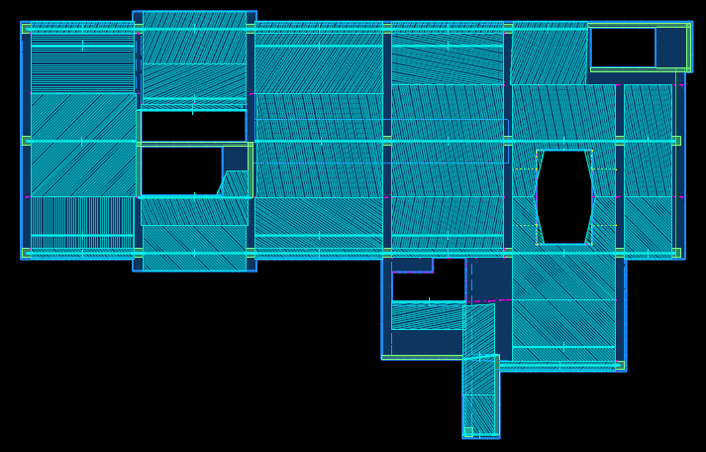
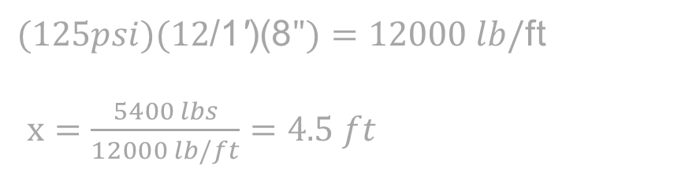

UVA’s New Library
Initial Number of Tendons
Distributed Direction:
Building Introduction
Problem Statement & Solution
Two-way System
PT System
  Tendon Layout
  Number of Tendons
  Deflections
  Final Layout
Lateral System
Cost and Schedule Analysis
System Comparison
Conclusion
Based on minimum precompression stress = 125 psi
27 kips/tendon after all stress losses
$(125psi)(12\text{/1}\text{′}\text{)(8}")=12000 lb/$ft
$x=\frac{5400 lbs}{12000 lb/ft}=4.5 ft$
Banded Direction:
ACI318-11 18.12.4 :
Maximum tendon spacing of: 5 feet
  8 x Slab Thickness
A$=({24.33}^{′})(12\text{/1}\text{′}\text{)(8}")=2429 {in}^{2}$
$P=\left(125psi\right)\left(2429{in}^{2}\right)=304kips$
$Tendons=\frac{304 kips}{27 kips/tendon}=11 Tendons$
Max.

Slide 20
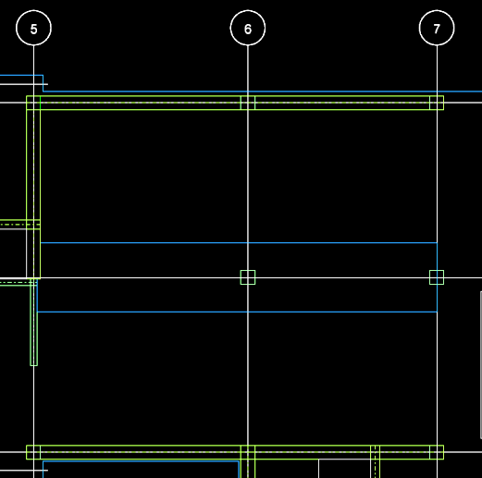
UVA’s New Library
Adjusting Number of Tendons
Building Introduction
Problem Statement & Solution
Two-way System
PT System
  Tendon Layout
  Number of Tendons
  Deflections
  Final Layout
Lateral System
Cost and Schedule Analysis
System Comparison
Conclusion
Maximum tensile stress = 6√f ’c = 424.3 psi
Max precompression stress = 350 psi
Span D5-D6 and D6-D7:
  Maximum number of tendons = 32
  Required number of tendons = 34
Solution: 12” deep, 10’-0” wide shallow beam
Required number of tendons: 26
FAIL

Slide 21
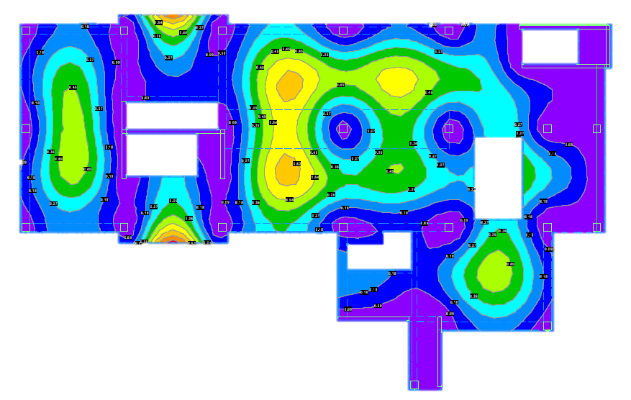
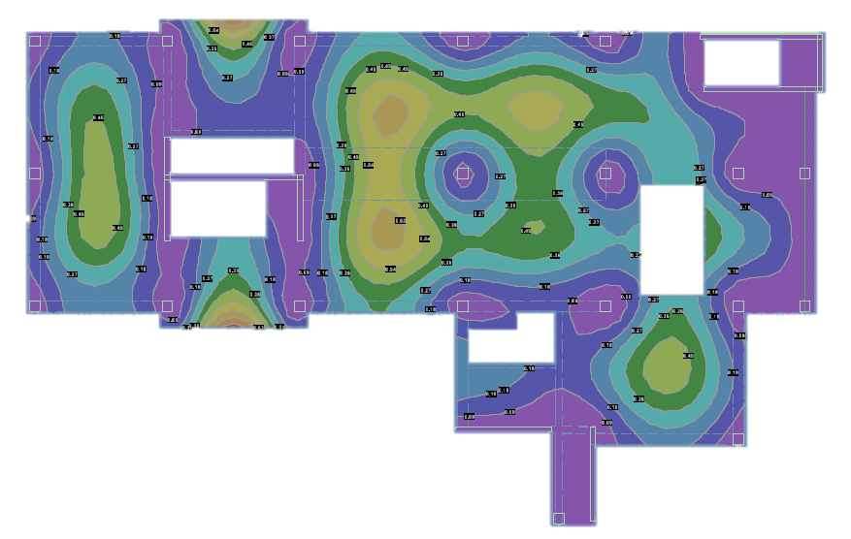
UVA’s New Library
Deflections
Building Introduction
Problem Statement & Solution
Two-way System
PT System
  Tendon Layout
  Number of Tendons
  Deflections
  Final Layout
Lateral System
Cost and Schedule Analysis
System Comparison
Conclusion
Maximum Allowable Deflection: L/480
Class U system →
  Deflections calculated using uncracked section properties.
2(Self Dead)+2(Balance)+3(Other-Dead)+1.6(Live)
Span | Length (FT) | Deflection | L/480 | Pass/Fail
5D - 6D | 31 | 0.578 | 0.620 | Pass

Slide 22
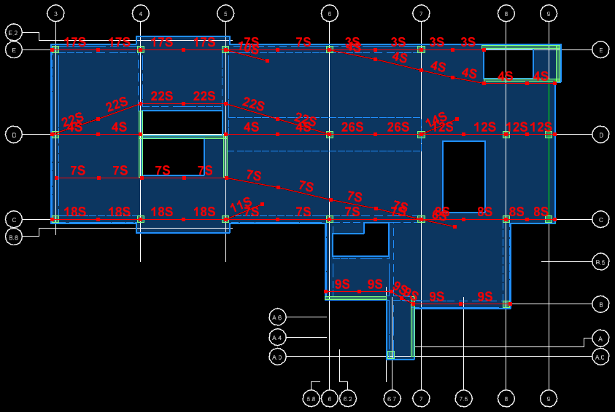
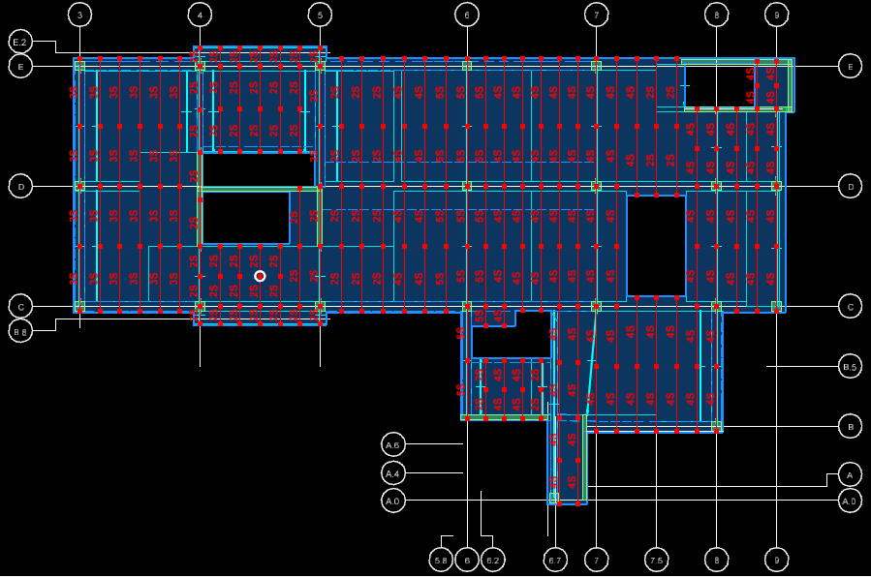
UVA’s New Library
Final Layout
Building Introduction
Problem Statement & Solution
Two-way System
PT System
  Tendon Layout
  Number of Tendons
  Deflections
  Final Design
Lateral System
Cost and Schedule Analysis
System Comparison
Conclusion

Slide 23
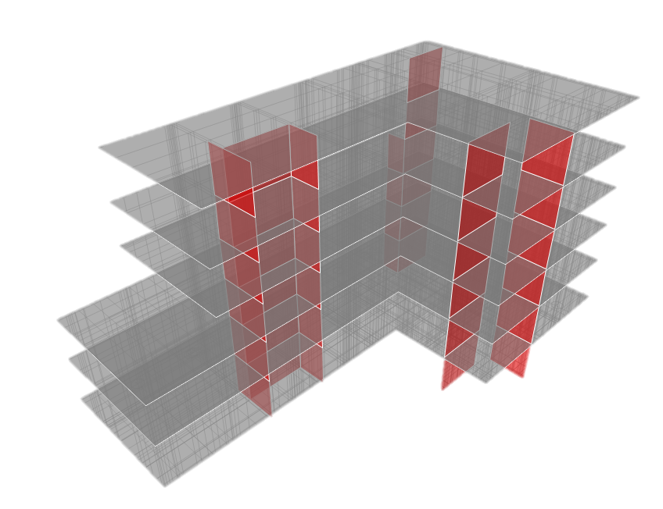
UVA’s New Library
Building Introduction
Problem Statement & Solution
Two-way System
PT System
Lateral System
Cost and Schedule Analysis
System Comparison
Conclusion
Lateral System Analysis

Slide 24
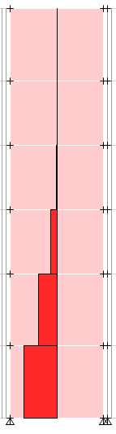
UVA’s New Library
Shear Force Comparison
Drift Comparison
Building Introduction
Problem Statement & Solution
Two-way System
PT System
Lateral System
Cost and Schedule Analysis
System Comparison
Conclusion
Max Shear due to Soil Loads: 2294 K
Max Allowable Building Deflection: 3.1”
Max Allowable Story Drift: 3.2”
Comparison of Shear Forces
 | Shear Capacity (k) | Force (k)
Original Loads | 4752 | 3071
New Loads | 4934 | 3908
Percent Increase | 3.8% | 27.3%
Comparison of Maximum Drifts
 | Max Building Deflections (in) [Wind Case 4 +M Same Direction] | Max Story Drift [Y-Direction +M]
Original Loads | 2.16 | 2.81
New Loads | 2.72 | 3.18
Percent Increase | 25.9% | 13.2%

Slide 25
UVA’s New Library
Building Introduction
Problem Statement & Solution
Two-way System
PT System
Lateral System
Cost and Schedule Analysis
System Comparison
Conclusion
Cost and Schedule Analysis

Slide 26
UVA’s New Library
Steel System Cost
Concrete System Cost
Building Introduction
Problem Statement & Solution
Two-way System
PT System
Lateral System
Cost and Schedule Analysis
  Cost Analysis
  Schedule Analysis
System Comparison
Conclusion
Item | Amount
Formwork | 553622
Structural Concrete | 273961
Finishing | 42863
Placement | 51167
Reinforcement | 231115
Total Cost | $ 1,268,000
  Reuse of formwork
  +$8/CY for accelerated slab concrete mix
  +$2/Month for rented column forms
  Structure ~ 3% of total project cost

Slide 27
UVA’s New Library
Cost Comparison
Total System Cost
Steel | Concrete
$ 1,484,019 | $1,268,000
Building Introduction
Problem Statement & Solution
Two-way System
PT System
Lateral System
Cost and Schedule Analysis
  Cost Analysis
  Schedule Analysis
System Comparison
Conclusion
  15% Project Cost Savings
Per Square Foot Cost
Steel | Concrete
$ 24.50 | $ 21.00

Slide 28
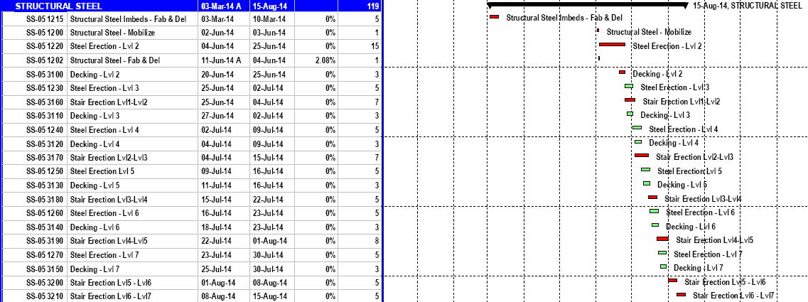
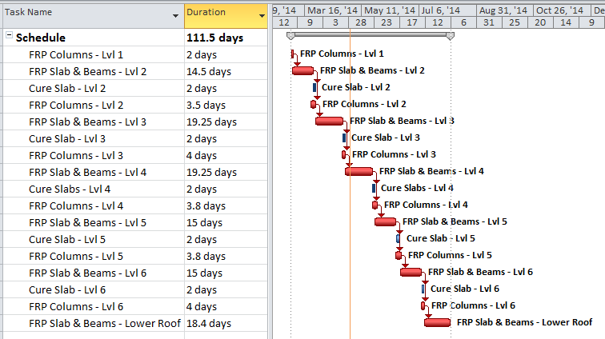
UVA’s New Library
Steel System Schedule
Concrete System Schedule
Building Introduction
Problem Statement & Solution
Two-way System
PT System
Lateral System
Cost and Schedule Analysis
  Cost Analysis
  Schedule Analysis
System Comparison
Conclusion
Image Courtesy of Cannon Design
  Construction length: 119 days
  March 3rd, 2014 – August 15th, 2014
  Construction length: 112 days
  March 3rd, 2014 – April 5th, 2014

Slide 29
UVA’s New Library
Schedule Comparison
Building Introduction
Problem Statement & Solution
Two-way System
PT System
Lateral System
Cost and Schedule Analysis
  Cost Analysis
  Schedule Analysis
System Comparison
Conclusion
Total System Duration
Steel | Concrete
119 Days | 112 Days
  7 Day Project Duration Decrease

Slide 30
UVA’s New Library
System Comparison
Building Introduction
Problem Statement & Solution
Two-way System
PT System
Lateral System
Cost and Schedule Analysis
System Comparison
Conclusion
  Construction Type
    Steel: 1B
    Concrete: 1B
  Cost
    Steel: $1.5 Million
    Concrete: $1.2 Million
  Construction Time
    Steel: 119 Days
    Concrete: 112 Days
  No Change
  15% Savings
  Floor Depth
Member | Steel | Concrete
Slab/Floor (in) | 6.5 | 10
Interior Beam (in) | 16 | -
Interior Girder (in) | 24 | 24
Maximum Edge Beam (in) | 30 | 30
Total Decrease | 6.5 in – 12.5 in
  7 Day Decrease
  Special Consideration:
    Concrete Construction Crew

Slide 31

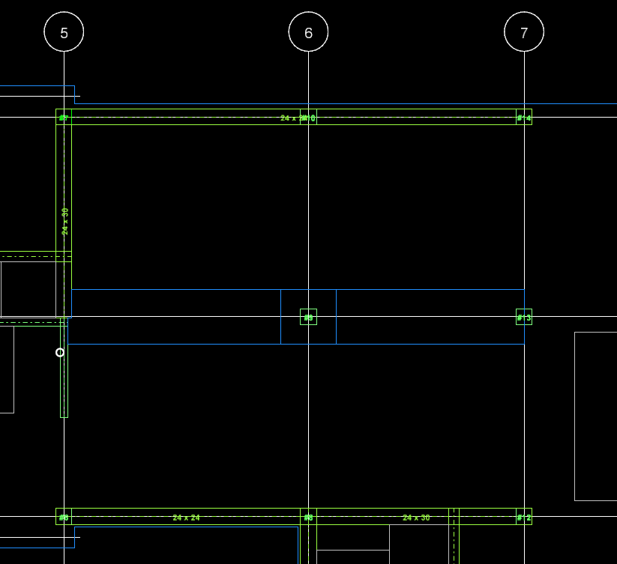
UVA’s New Library
Conclusions
Building Introduction
Problem Statement & Solution
Two-way System
PT System
Lateral System
Cost and Schedule Analysis
System Comparison
Conclusion
  Redesign structural systems as a two-way
  concrete slab system
  Address deflections in longer span bays
  Investigate the feasibility of a post-tensioned system
  Determine feasibility of a concrete system
    Consider cost and schedule impact
  15% Cost Savings + 7 Day Schedule Decrease

Slide 32
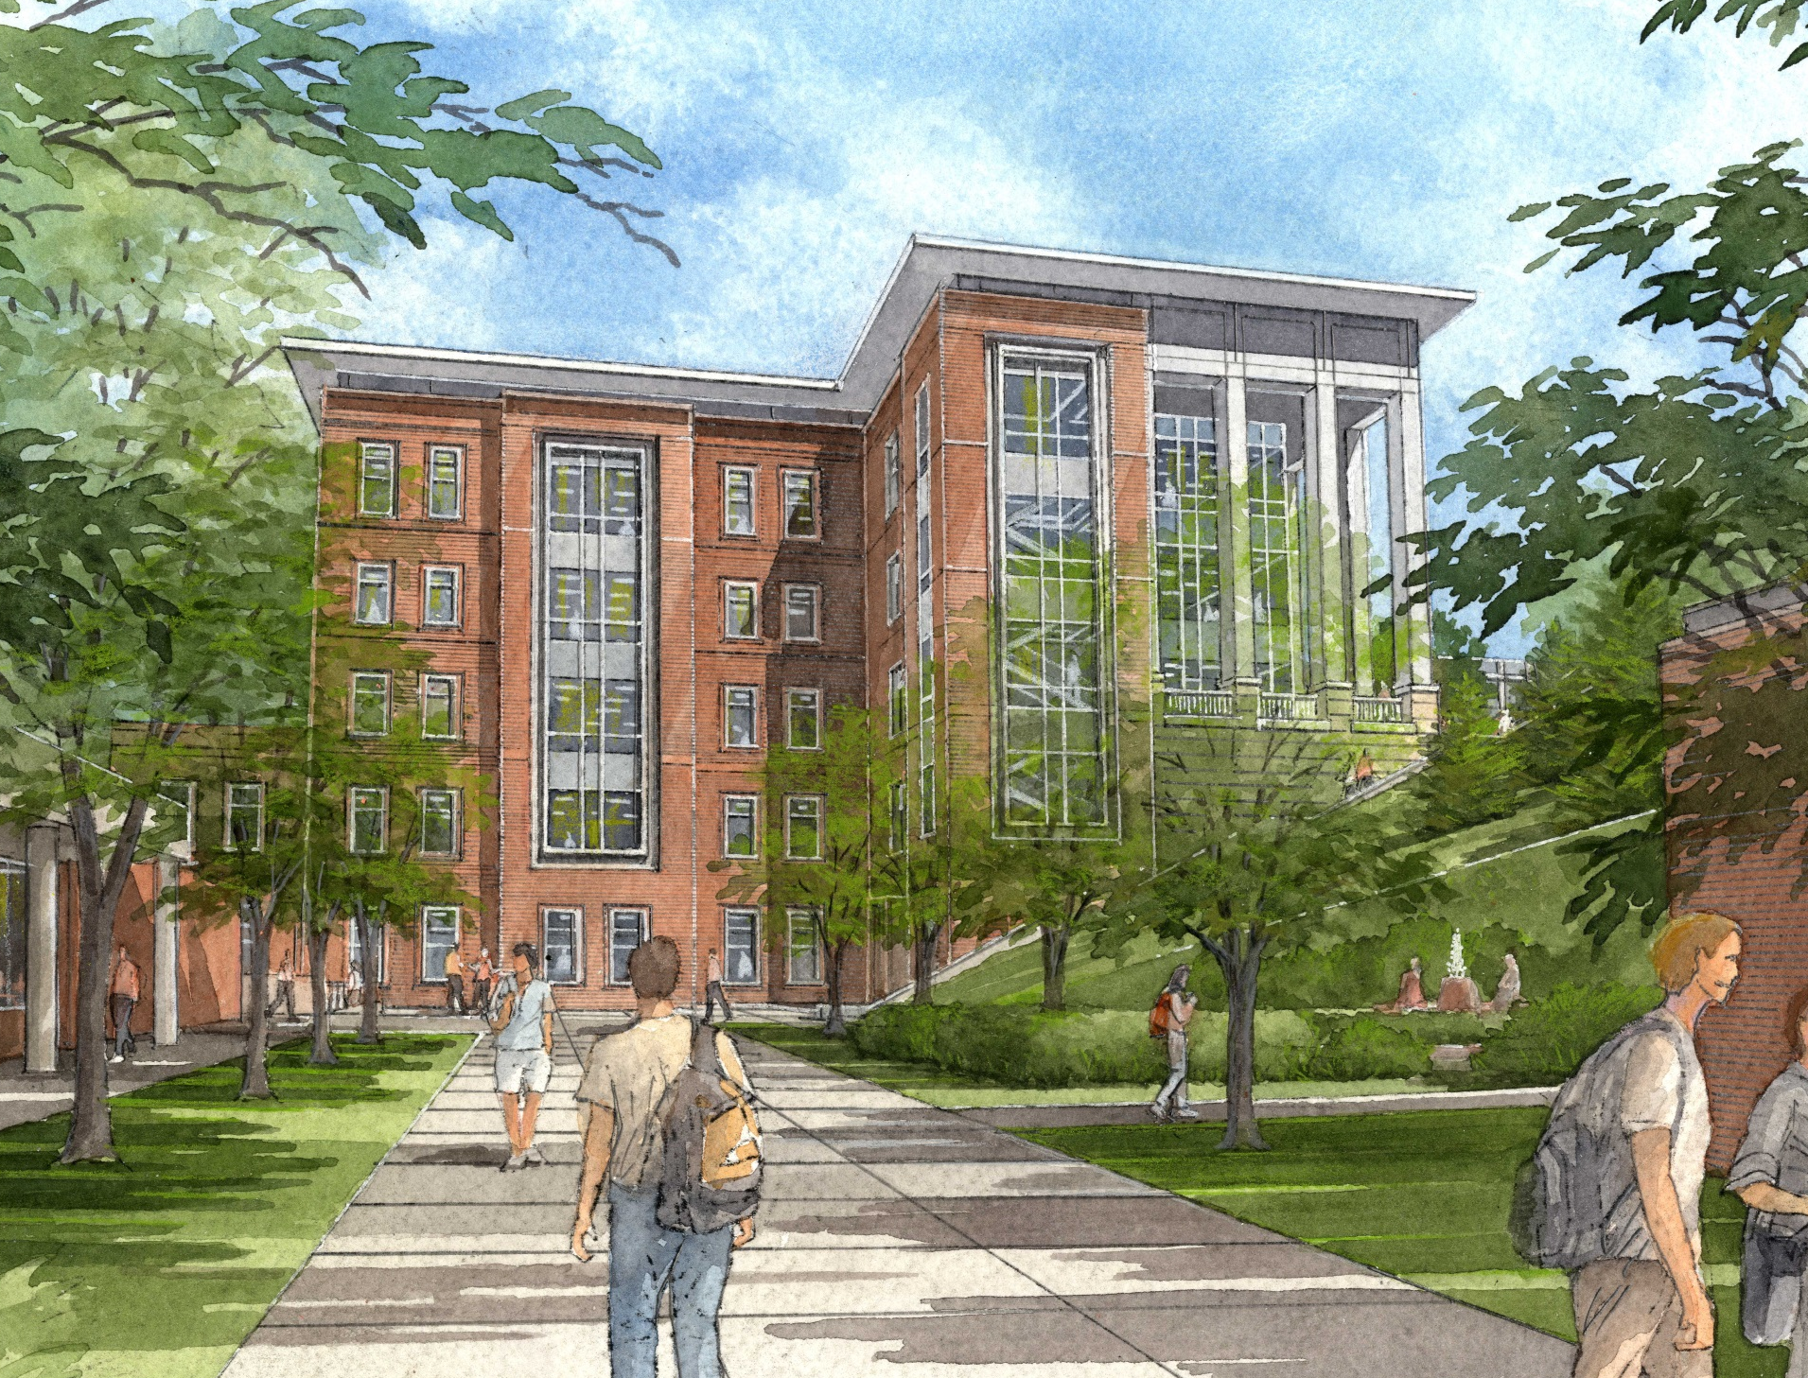
UVA’s New Library
Acknowledgements
Building Introduction
Problem Statement & Solution
Two-way System
PT System
Lateral System
Cost and Schedule Analysis
System Comparison
Conclusion
A Special Thanks to:
  Cannon Design | Rachel Chicchi
  SK&A Engineers | Walid Choueiri & Hakan Onel
  AE Faculty | Professor Heather Sustersic
  My Family, Fiancé, and Friends
  Jesus Christ
Image Courtesy of Cannon Design

Slide 33
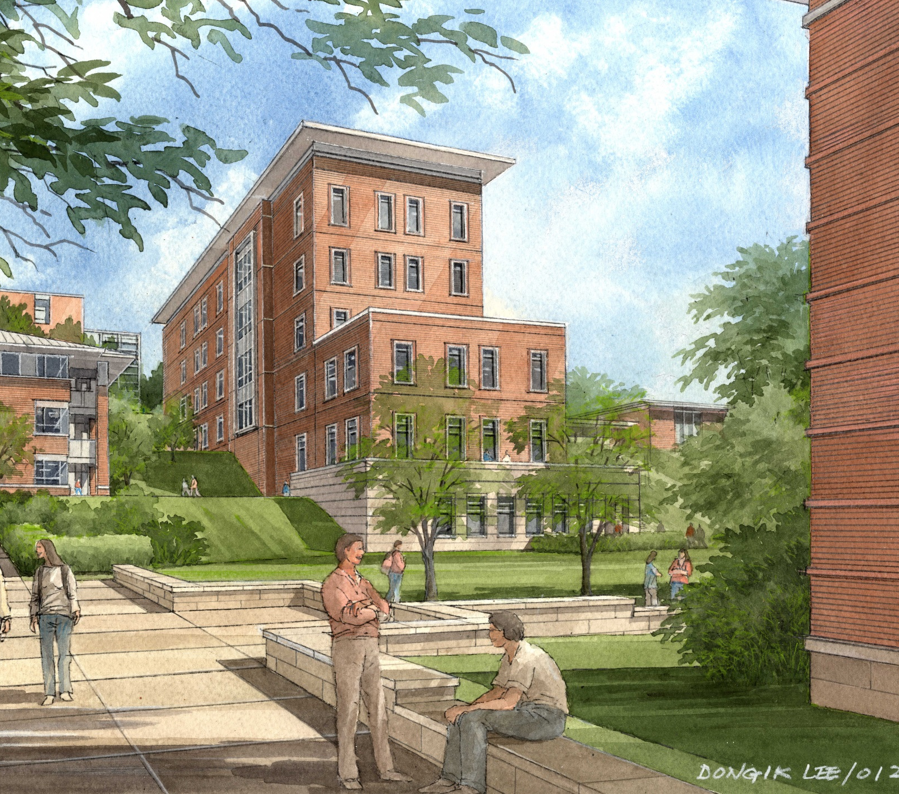
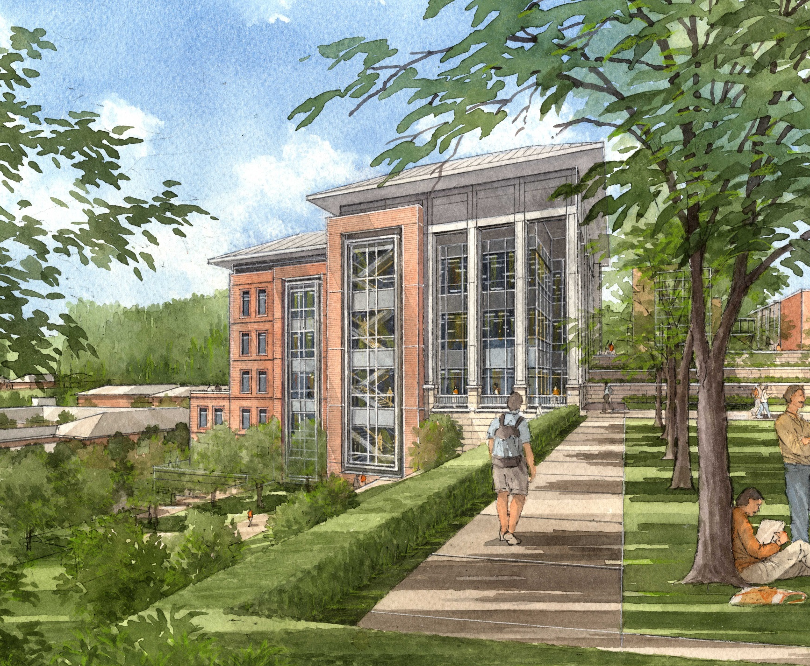
Questions and Comments?
Image Courtesy of Cannon Design
Image Courtesy of Cannon Design

Slide 34
Appendix Slides
Verification of Output
PT Deflections
Waterproof Membranes
Balancing Tendons
Edge Deflections
Drainage Calculations
Two-way Deflections
Water Path

Slide 35
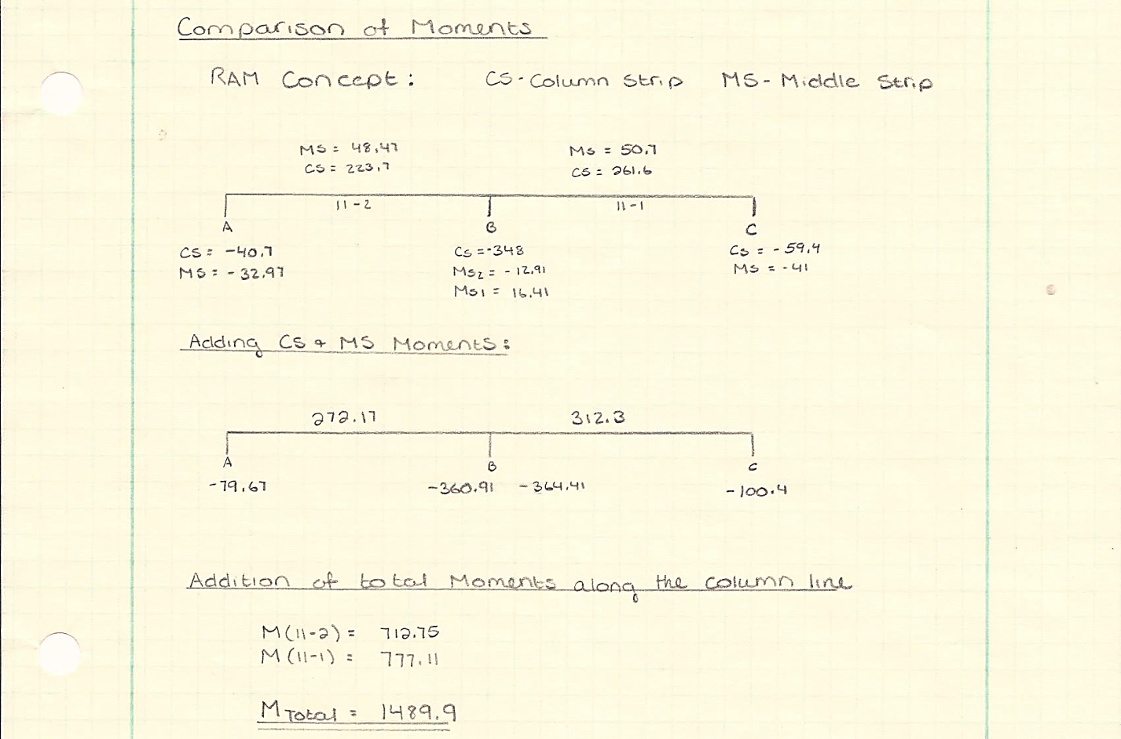
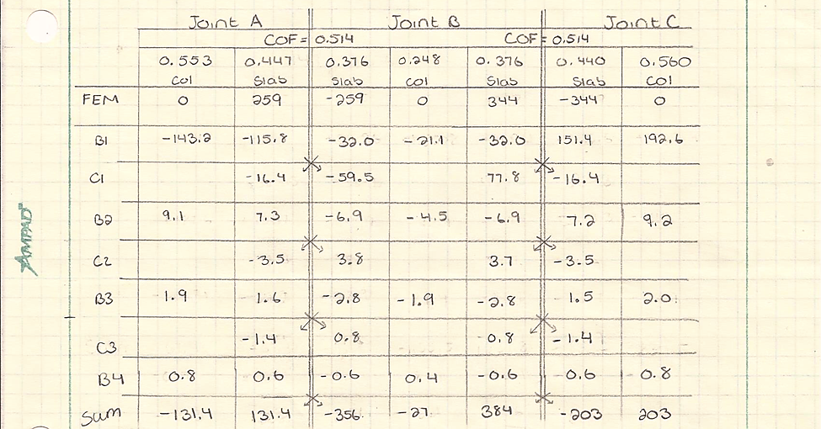
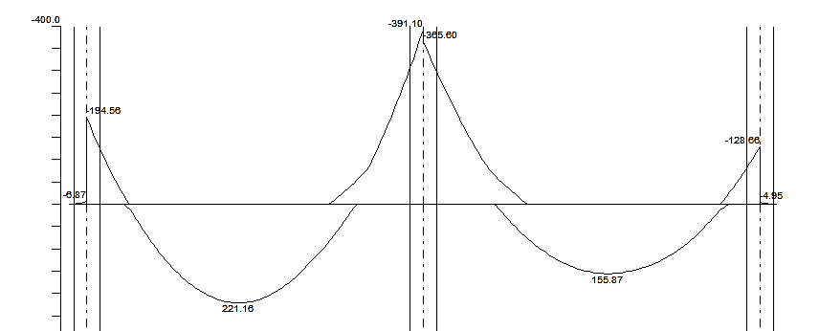
UVA’s New Library
Verification of Output
Return to Appendix Index
Percent Different in Total Design Moments
 | Hand Calculations/SP Slab | RAM Concept | % Difference
Total Moment in Span A-B | 650.13 | 712.75 | 9%
Total Moment in Span B-C | 806.82 | 777.11 | 4%
Total Moment in Both Spans | 1456.95 | 1489.86 | 2%
Joint C
Joint B
Joint A

Slide 36
UVA’s New Library
Verification of Output
One-Way Shear
 | RAM Concept | Hand Calculations | % Difference
Max Shear Demand | 143.1 K | 143.1 K | 0%
Max Capacity | 302.6K | 278.4 K | 8%
Shear Stud Rail Design
 | RAM Concept | Decon STDesign
Stud Rails per Column | 12 | 12
Studs per Stud Rail | 12 | 13
Stud Spacing | 3.75 in | 3.75
Return to Appendix Index
Two-Way Shear
 | RAM Concept | Hand Calculations | % Difference
Max Shear Demand | 284.6 K | 280 K | 1.6%
Max Capacity | 189.7 K | 189.9 K | 0.1%

Slide 37
UVA’s New Library
Balancing the Tendons
Balancing Load = weight of design strip
Lower Limit = 50% of design strip weight
Upper Limit = 125% of design strip weight
Return to Appendix Index

Slide 38
UVA’s New Library
Two-way System Deflections
ECR in RAM Concept:
  Default ECR = 3.35 (ACI209)
  To account for cracking RAM Concept uses a conservative approach:
      New ECR = ECR * (M_{service}/M_{crack})
Initial ECR Adjustment:
  ACI318-11
    Initial factor = 1
    Long term factor = 2 (5 + Years w/ no compression reinforcement)
  Adjusted ECR = 3
Return to Appendix Index

Slide 39

UVA’s New Library
Two-way System Deflections
Trial 1: Weighted Average
  $\frac{Live Load}{Live Load+Dead Load}(1.6)+ \frac{Dead Load}{Live Load+Dead Load}$ (ECR)
  $\frac{80}{80+141.5}(1.6)+ \frac{141.5}{80+141.5}$ (3) = 2.5
Trial 2: Compression Reinforcement
  Compression reinforcement changes the long term deflection factor
  Based on trial runs in RAM Concept an ECR < 1 from compression reinforcement would be required → Unrealistic!
Return to Appendix Index
Span | Length (FT) | Deflection | L/? | Pass/Fail
5D - 6D | 31 | 1.27 | 0.775 | Fail

Slide 40
UVA’s New Library
Two-way System Deflections
Trial 3: Drop Panel
  First size: 6’ x 6’ x 6”
Second size: 7’ x 7’ x 6”
Return to Appendix Index
Span | Length (FT) | Deflection | L/480 | Pass/Fail
5D - 6D | 31 | 1.0 | 0.775 | Fail
6D - 7D | 27.33 | 0.669 | 0.683 | Pass
5E - 6D | 40 | 1.07 | 1.0 | Fail
6E - 7D | 37.33 | 0.971 | 0.933 | Fail
5C - 6D | 40 | 1.04 | 1.0 | Fail
Span | Length (FT) | Deflection | L/480 | Pass/Fail
5D - 6D | 31 | 0.955 | 0.775 | Fail
6D - 7D | 27.33 | 0.592 | 0.683 | Pass
5E - 6D | 40 | 1.03 | 1.0 | Fail
6E - 7D | 37.33 | 0.92 | 0.933 | Pass
5C - 6D | 40 | 0.986 | 1.0 | Pass

Slide 41
UVA’s New Library
Two-way System Deflections
Trial 4: Larger Drop Panel or Shallow Beam
  Drop Panel: 8’ x 8’ x 6”
Shallow Beam: 7’ x 7’ x 4”
Return to Appendix Index
Span | Length (FT) | Deflection | L/480 | Pass/Fail
5D - 6D | 31 | 0.943 | 0.775 | Fail
6D - 7D | 27.33 | 0.614 | 0.683 | Pass
5E - 6D | 40 | 1.02 | 1.0 | Fail
6E - 7D | 37.33 | 0.943 | 0.933 | Fail
5C - 6D | 40 | 0.974 | 1.0 | Pass
Span | Length (FT) | Deflection | L/480 | Pass/Fail
5D - 6D | 31 | 0.709 | 0.775 | Pass
6D - 7D | 27.33 | 0.511 | 0.683 | Pass
5E - 6D | 40 | 0.875 | 1.0 | Pass
6E - 7D | 37.33 | 0.817 | 0.933 | Pass
5C - 6D | 40 | 0.827 | 1.0 | Pass

Slide 42
UVA’s New Library
PT System Deflections
ACI318-11 Section 9.5.2.5:
  Long term deflection factor of 5 or more years= 2
Sustained loads = DL + SW + portion of LL
30% sustained LL for commercial building occupancies of office and residential
SW DL not counted in instantaneous deflections due to these deflections happening prior to the attachment of non-structural elements
Total Deflection
  =Service instantaneous + Long term
  =(SID +LL) +2(SW DL + SID+0.3LL)
  =2(SW DL) + 3(SID) + 1.6(LL)
Return to Appendix Index

Slide 43
UVA’s New Library
Edge Deflections: Two-way
Edge Deflections: PT
Span | Span Length (FT) | Initial Deflections (in) | Final Deflections (in) | Sustained Deflections (in) | L/600 (in) | Pass/Fail
3C-D3 | 25.33 | 0.018 | 0.19 | 0.17 | 0.51 | Pass
D3-E3 | 25.33 | 0.016 | 0.18 | 0.16 | 0.51 | Pass
3E-4E | 25.33 | 0.037 | 0.31 | 0.27 | 0.51 | Pass
4E-5E | 25.33 | 0.059 | 0.55 | 0.49 | 0.51 | Pass
5E-6E | 31 | 0.044 | 0.52 | 0.48 | 0.62 | Pass
6E-7E | 27.33 | 0.020 | 0.35 | 0.33 | 0.55 | Pass
7E-8E | 25.33 | 0.007 | 0.18 | 0.17 | 0.51 | Pass
9D-9C | 23.33 | 0.000 | 0.03 | 0.03 | 0.47 | Pass
9C-8C | 12.67 | 0.000 | 0.10 | 0.10 | 0.25 | Pass
8B-7B | 25.33 | 0.060 | 0.50 | 0.44 | 0.51 | Pass
6C-5C | 31 | 0.045 | 0.53 | 0.49 | 0.62 | Pass
5C-4C | 25.33 | 0.059 | 0.56 | 0.50 | 0.51 | Pass
4C-3C | 25.33 | 0.029 | 0.23 | 0.20 | 0.51 | Pass
Span | Span Length (FT) | Deflections (in) | L/600 (in) | Pass/Fail
3C-D3 | 25.33 | 0.14 | 0.51 | Pass
D3-E3 | 25.33 | 0.13 | 0.51 | Pass
3E-4E | 25.33 | 0.21 | 0.51 | Pass
4E-5E | 25.33 | 0.47 | 0.51 | Pass
5E-6E | 31 | 0.32 | 0.62 | Pass
6E-7E | 27.33 | 0.21 | 0.55 | Pass
7E-8E | 25.33 | 0.21 | 0.51 | Pass
9D-9C | 23.33 | 0.03 | 0.47 | Pass
9C-8C | 12.67 | 0.03 | 0.25 | Pass
8B-7B | 25.33 | 0.23 | 0.51 | Pass
6C-5C | 31 | 0.37 | 0.62 | Pass
5C-4C | 25.33 | 0.50 | 0.51 | Pass
4C-3C | 25.33 | 0.25 | 0.51 | Pass
Return to Appendix Index

Slide 44
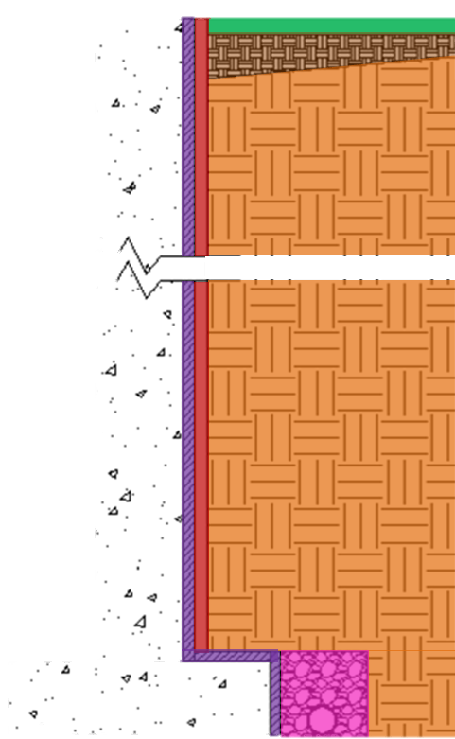
UVA’s New Library
Water Path
  Compacting Clay
  - 10” – 12” Thick
  - Thins out to top soil 12’-20’ from building
  Backfill
  -recommended by geotechnical engineer
  -full gradation soil with minimal fines
  Protection Board
  -1/2” thick
  -plastic & geotextile material
  1. Top Soil
  2. Compacting Clay
  3. Backfill
  4. Protection Board
  5. Waterproofing Membrane
  6. VADOT 57 Stone
Return to Appendix Index

Slide 45
UVA’s New Library
Waterproofing Membranes
Foundation Wall: Bituthane System 4000
  Thickness: 1/16th
  Excellent adhesion to the wall through the use of the System 4000 Surface Conditioner
      Water based, latex surface treatment
      High tack finish to the treated subtract
      Formulated to bind site dust and concrete efflorescence
  Reduces inventory and handling costs by packaging the conditioner and membrane together
Basement Slab: Bituthane System 4000
  Thickness: ½”
  Installed between the mud slab and floor slab
  Forms a permanent seal against ground water
  High tensile strength to provide resistance against the stress of ground settlement
Return to Appendix Index

Slide 46
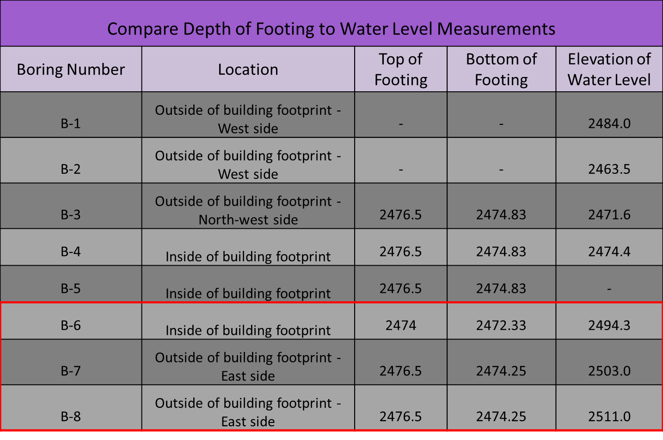
UVA’s New Library
Drainage Calculations
At the time of boring all holes were dry
48-72 hours later all holes showed water levels
All holes were 3 ¼” in diameter
Return to Appendix Index

Slide 47
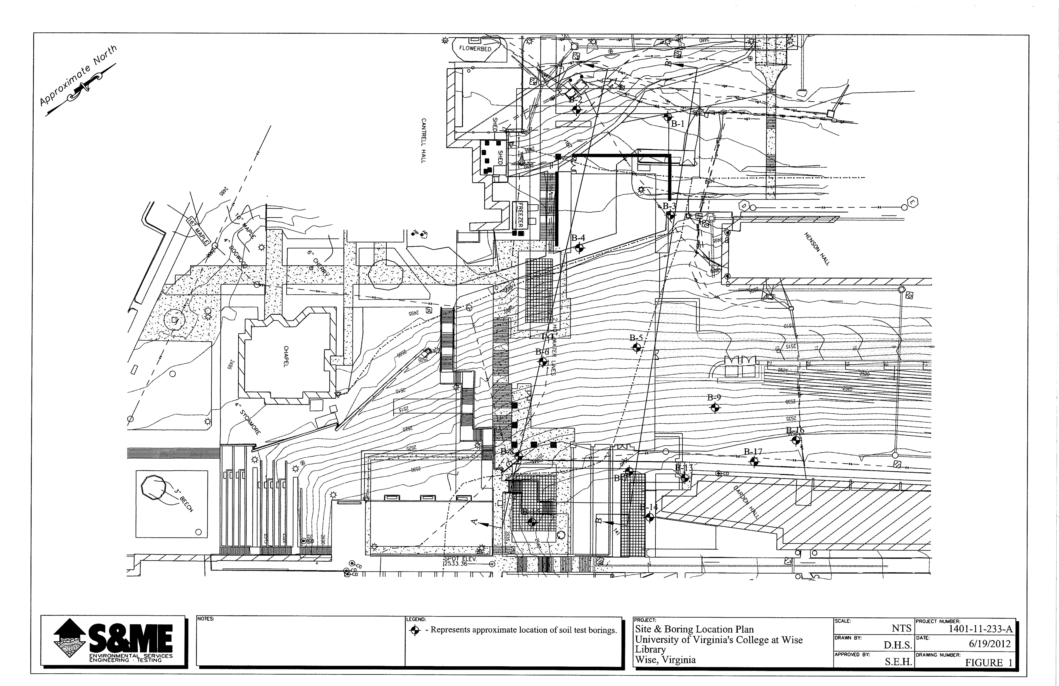
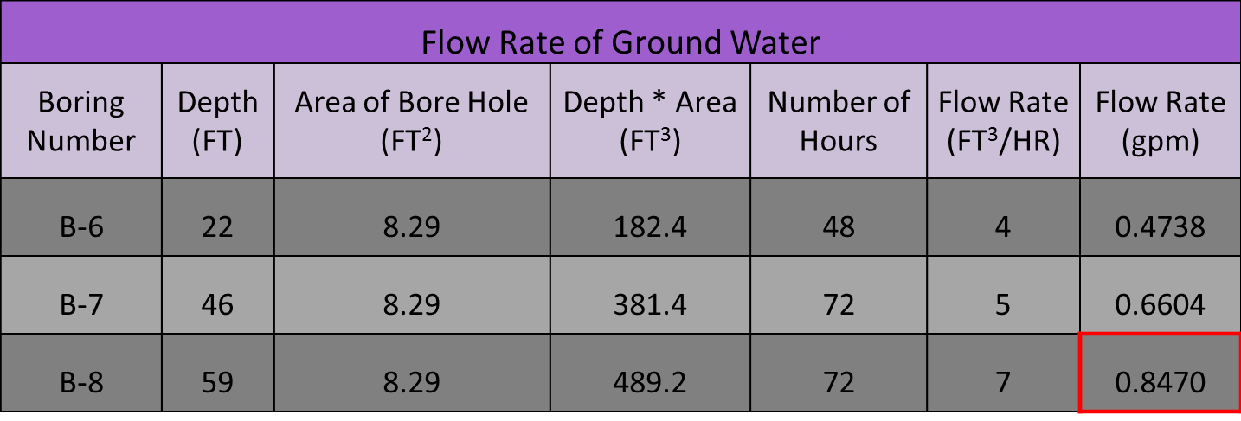
UVA’s New Library
Drainage Calculations
Return to Appendix Index

Slide 48
UVA’s New Library
Drainage Calculations
Average rainfall rates Bristol, VA = 0.028 gpm/SF
Tributary Area:
  10’ away from structure (half the distance to the surrounding storm drain)
  2870 SF
Total rainfall per pipe = 40.2 gpm
Return to Appendix Index

Slide 49

UVA’s New Library
Drainage Pipe Design
Using Perforated PVC Drainage Pipe:
  4” pipe at the base of the foundation walls
  (2) 4” pipe beneath the slab-on-grade
Return to Appendix Index

